Slide 1

Telecom Churn Prediction
Group - A

Slide 2
Recap
What Is Churn?
Data Cleaning and Data interpretation
Developing Models (LR, Decision Trees ,SVM ,KNN)
Checking Accuracy with Imbalanced data.
Improving Accuracy with Boosting methods(Ada Boost ,Gradient Boost, Bagging)
Dealing Imbalanced Data with Smote ,Over sampler & under sampler.

Slide 3
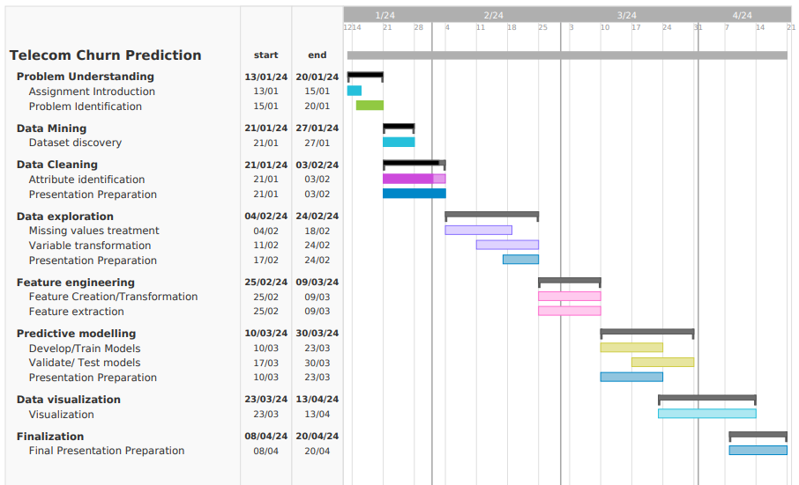
GANTT CHART

Slide 4
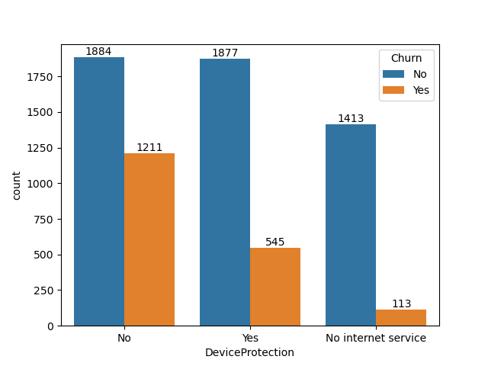
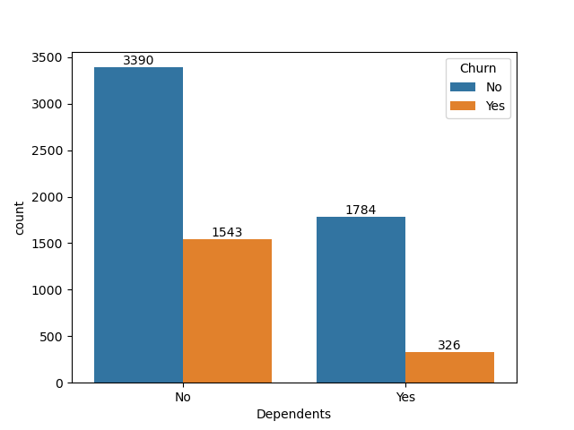
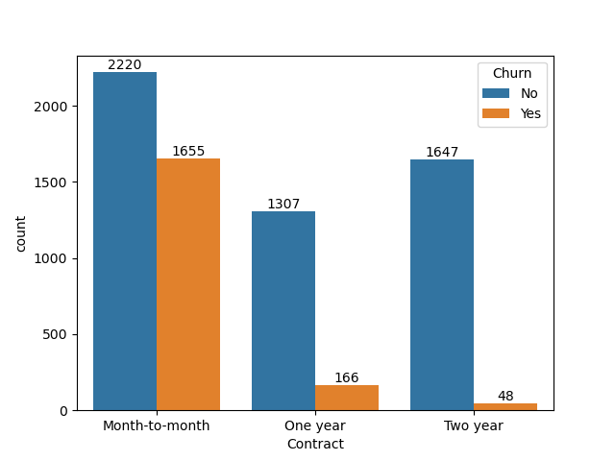
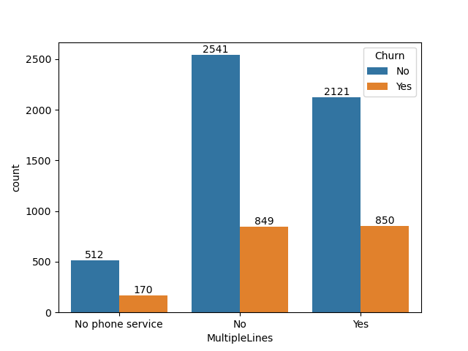
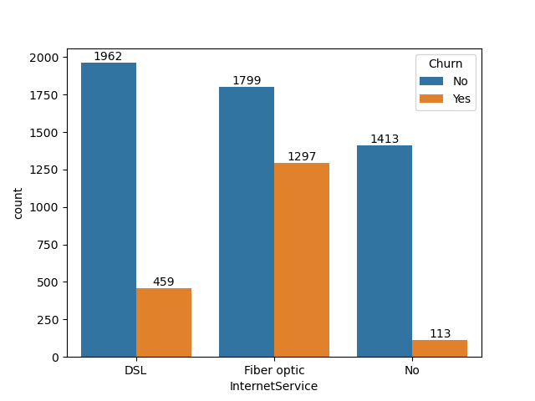
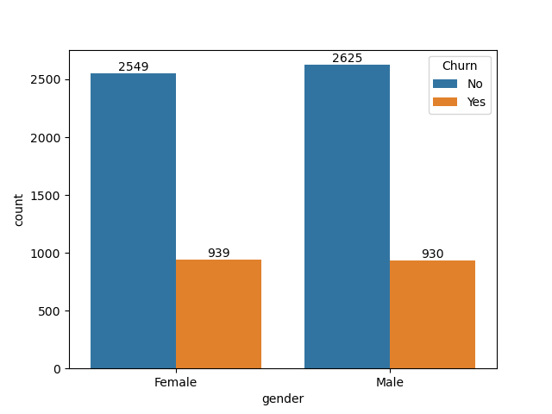
Data Overview

Slide 5
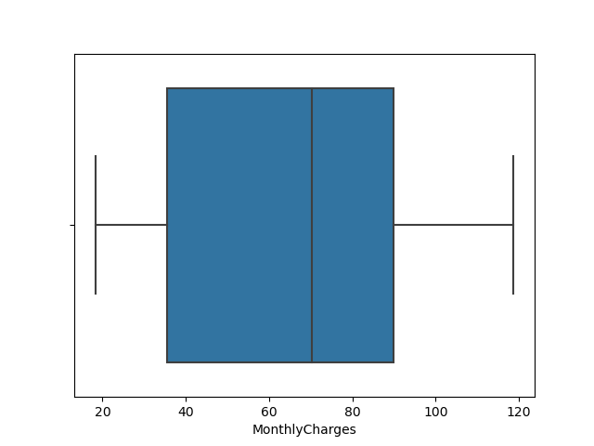
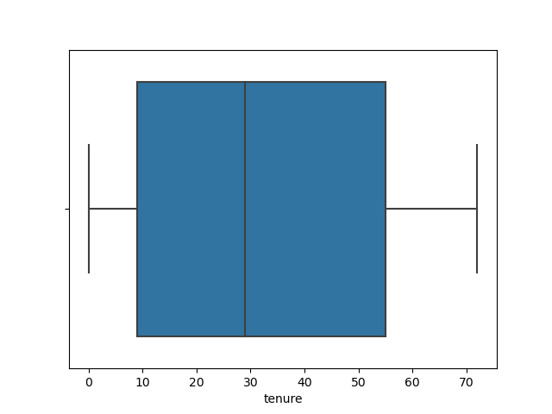
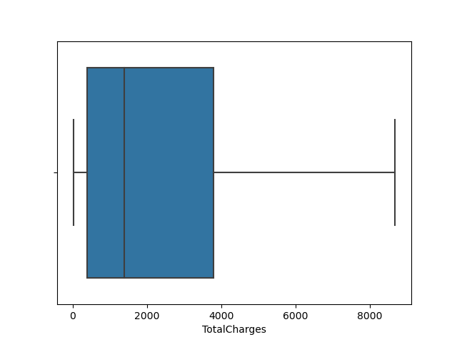
Box Plots For Outliers

Slide 6
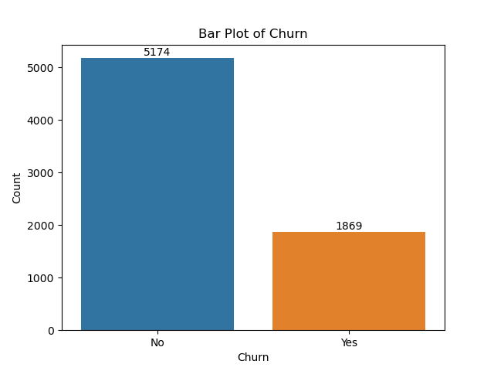
Data Imbalance of Target Variable

Slide 7
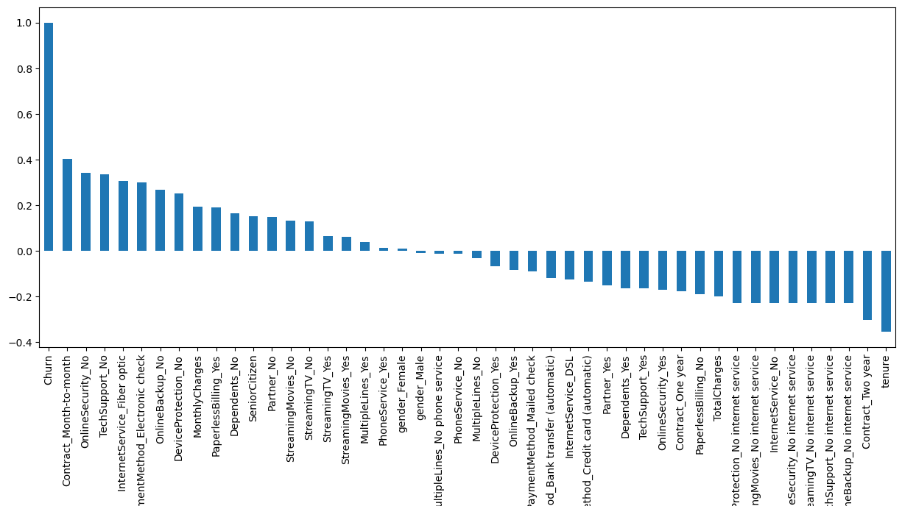
Correlation Plot

Slide 8
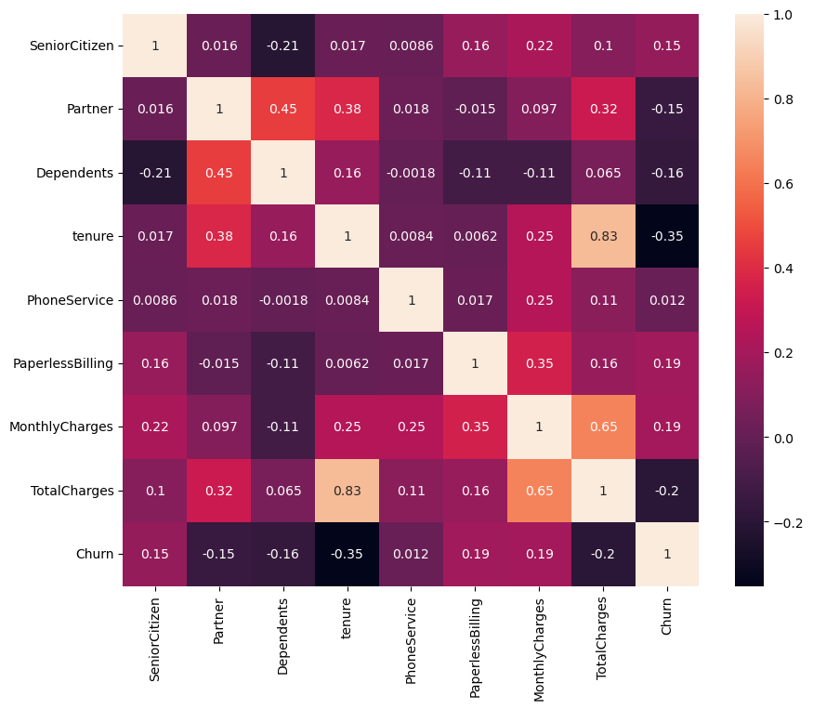
Correlation plot (Heatmap)

Slide 9
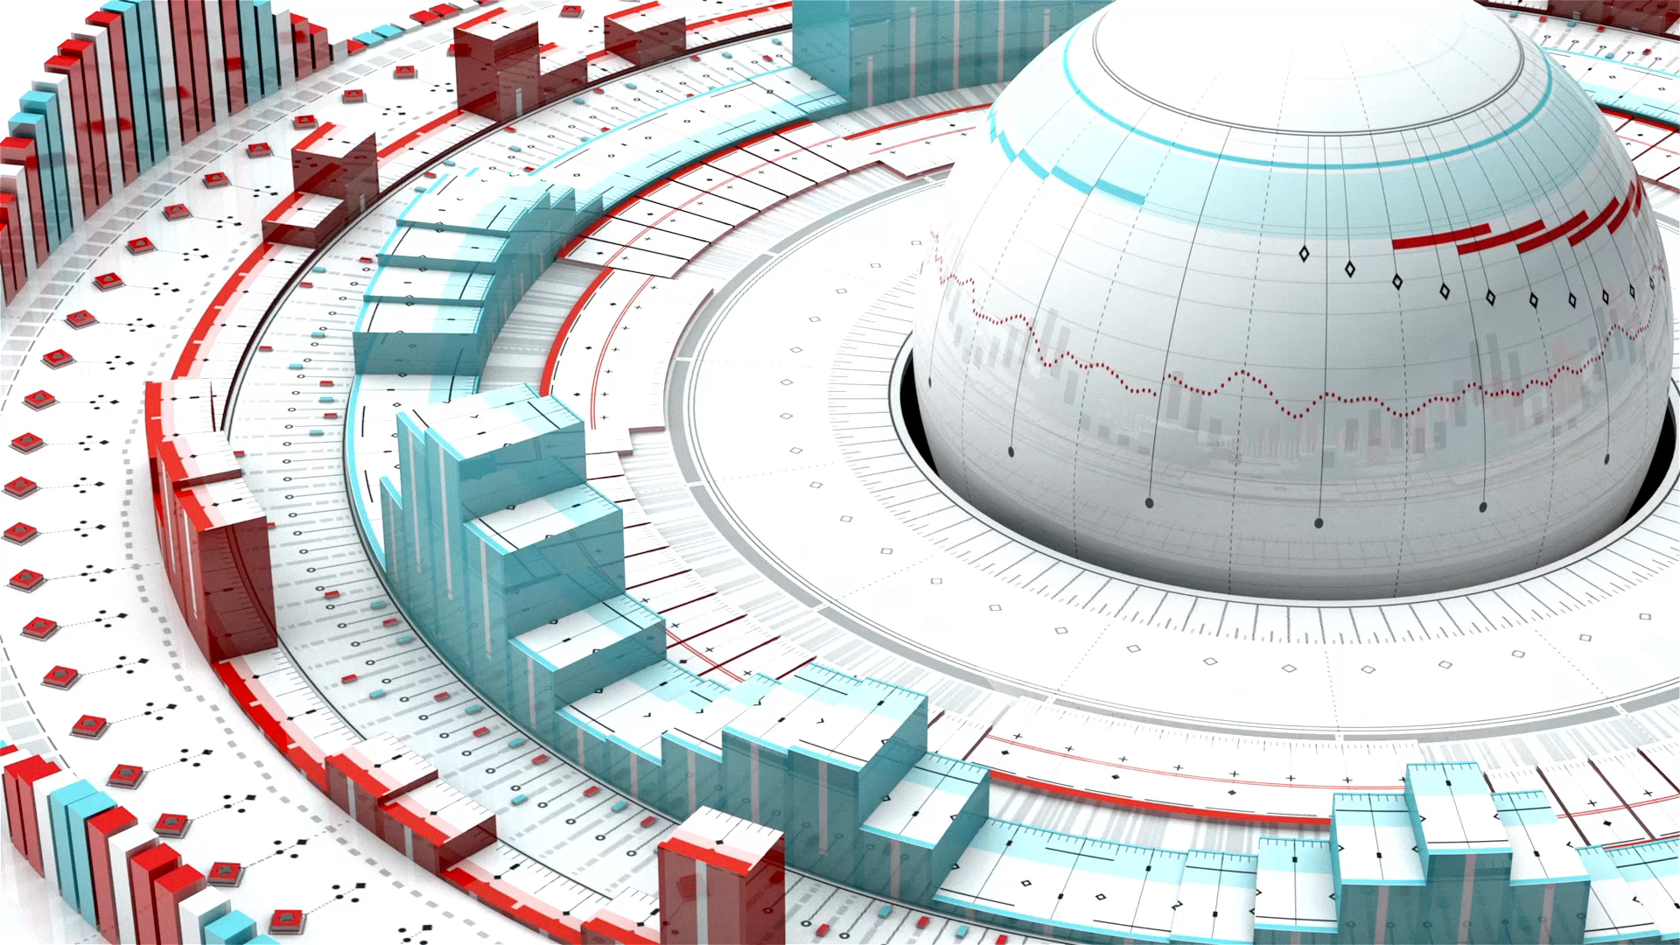
Model Building

Slide 10

Model Used
Logistic regression
Support Vector Machines
K-Nearest Neighbours
Classification and regression trees (Decision tree&Random Forest )
Gaussian Naive Bayes

Slide 11
Model Performance
Accuracy
Precession
Recall
Sensitivity
Specificity
Confusion Matrix
Area Under Curve(AUC)

Slide 12
What is Sensitivity and Specificity?
Sensitivity is the percentage of Data Point which are correctly identified by the test i.e. Identified as True Positives
Specificity is the percentage of Data Point which are correctly Excluded by the test i.e. Identified as False Negatives

Slide 13
Model Performance
Logistic Regression
Confusion Matrix:
[[1418 152]
[ 244 296]]
Accuracy: [0.81232227]
Sensitivity : [0.85318893]
Specificity : [0.66071429]
Precision: [0.90318471]
Recall: [0.85318893]
F-score: [0.87747525]
AUC: 0.7256664307619722
Support Vector Machine(SVM)
Confusion Matrix:
[[1433 137]
[ 271 269]]
Accuracy: [0.80663507]
Sensitivity : [0.84096244]
Specificity : [0.66256158]
Precision: [0.91273885]
Recall: [0.84096244]
F-score: [0.8753818]
AUC: 0.7054435008256664

Slide 14
Model Performance
K-Nearest Neighbours
Confusion Matrix:
[[1326 244]
[ 246 294]]
Accuracy: [0.76777251]
Sensitivity : [0.84351145]
Specificity : [0.5464684]
Precision: [0.84458599]
Recall: [0.84351145]
F-score: [0.84404838]
AUC: 0.6945152158527954
Random Forest
Confusion Matrix:
[[1412 158]
[ 283 257]]
Accuracy: [0.79099526]
Sensitivity : [0.83303835]
Specificity : [0.61927711]
Precision: [0.89936306]
Recall: [0.83303835]
F-score: [0.86493109]
AUC: 0.6876444916253833

Slide 15
Model Performance
Decision Trees
Confusion Matrix:
[[1260 310]
[ 268 272]]
Accuracy: [0.72606635]
Sensitivity : [0.82460733]
Specificity : [0.46735395]
Precision: [0.80254777]
Recall: [0.82460733]
F-score: [0.81342802]
AUC: 0.6531257372021703

Slide 16

Progress

Slide 17

Data Balancing
SMOTE
Under-Sampling
Over-Sampling

Slide 18
Testing Models On Balanced Data

Slide 19
Accuracy for Under sampler
Accuracy For Over sampler
KNN
Accuracy score: 0.681334
Logistic regression
Accuracy score (Logistic Regression): 0.721079
Random Forest
Accuracy-0.740951
SVC
Accuracy-0.723918
Decision Tree
Accuracy score (DECESION TREE): 676366
KNN
Accuracy score: 0.686302
Logistic regression
Accuracy score (Logistic Regression): 0.736693
Random Forest
Accuracy-0.787793
SVC
Accuracy-0.741661
Decision Tree
Accuracy score (DECESION TREE): 0.740951

Slide 20
Precision for Under sampler
Precision For Over sampler
KNN
Precision score: 0.406780
Logistic regression
Precision score (Logistic Regression):0.456747
Random Forest
Precision- 0.480072
SVC
Precision- 0.459930
Decision Tree
Precision score (DECESION TREE): 0.405042
KNN
Precision score: 0.406780
Logistic regression
Precision score (Logistic Regression): 0.474638
Random Forest
Precision- 0.552632
SVC
Precision- 0.479371
Decision Tree
Precision score (DECESION TREE): 0.476190

Slide 21
Recall for Under sampler
Recall For Over sampler
KNN
Recall score: 0.752187
Logistic regression
Recall score (Logistic Regression): 0.769679
Random Forest
Recall - 0.772595
SVC
Recall - 0.769679
Decision Tree
Recall score (DECESION TREE): 0.702624
KNN
Recall score: 0.629738
Logistic regression
Recall score (Logistic Regression): 0.763848
Random Forest
Recall -0.673469
SVC
Recall -0.711370
Decision Tree
Recall score (DECESION TREE): 0.641399

Slide 22
F1-score for Under sampler
F1-score For Over sampler
KNN
F1-score: 0.534715
Logistic regression
F1-score(Logistic Regression): 0.573290
Random Forest
F1-score - 0.592179
SVC
F1-score - 0.575791
Decision Tree
F1-score(DECESION TREE): 0.513859
KNN
F1-score: 0.494279
Logistic regression
F1-score(Logistic Regression): 0.585475
Random Forest
F1-score - 0.607096
SVC
F1-score - 0.572770
Decision Tree
F1-score(DECESION TREE): 0.546584

Slide 23
AUC for Under sampler
AUC For Over sampler
KNN
AUC : 0.757873
Logistic regression
AUC(Logistic Regression): 0.835412
Random Forest
AUC - 0.828351
SVC
AUC -0.800756
Decision Tree
AUC(DECESION TREE): 0.683334
KNN
AUC : 0.744310
Logistic regression
AUC(Logistic Regression): 0.838623
Random Forest
AUC - 0.831549
SVC
AUC - 0.806925
Decision Tree
AUC(DECESION TREE): 0.707191

Slide 24
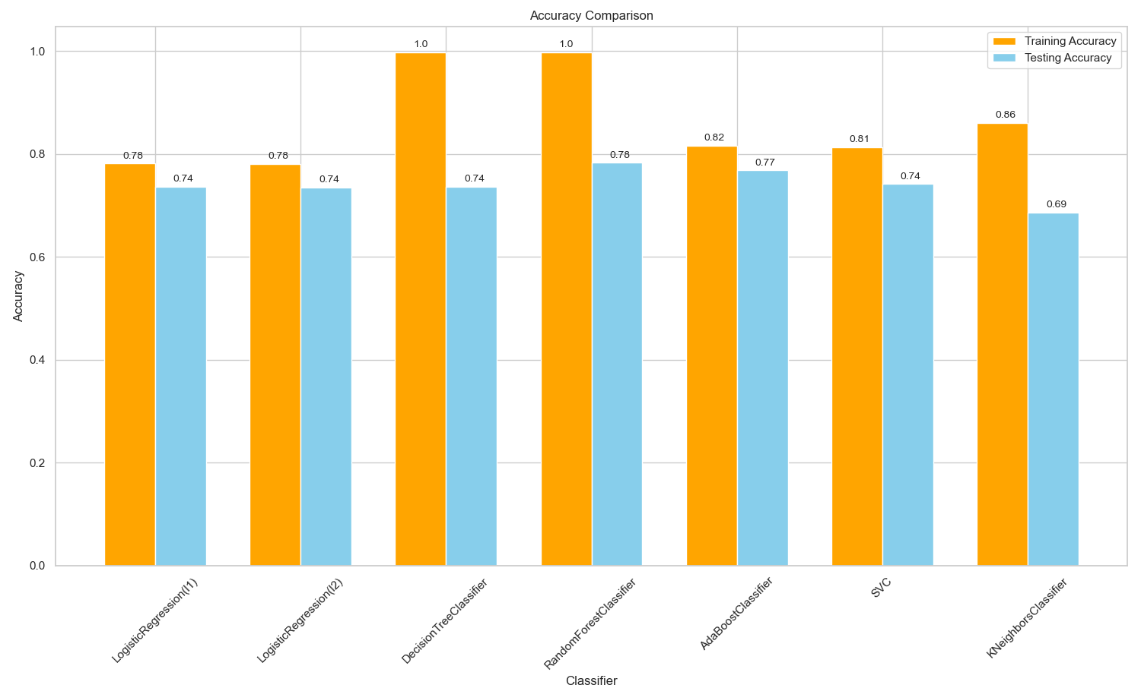
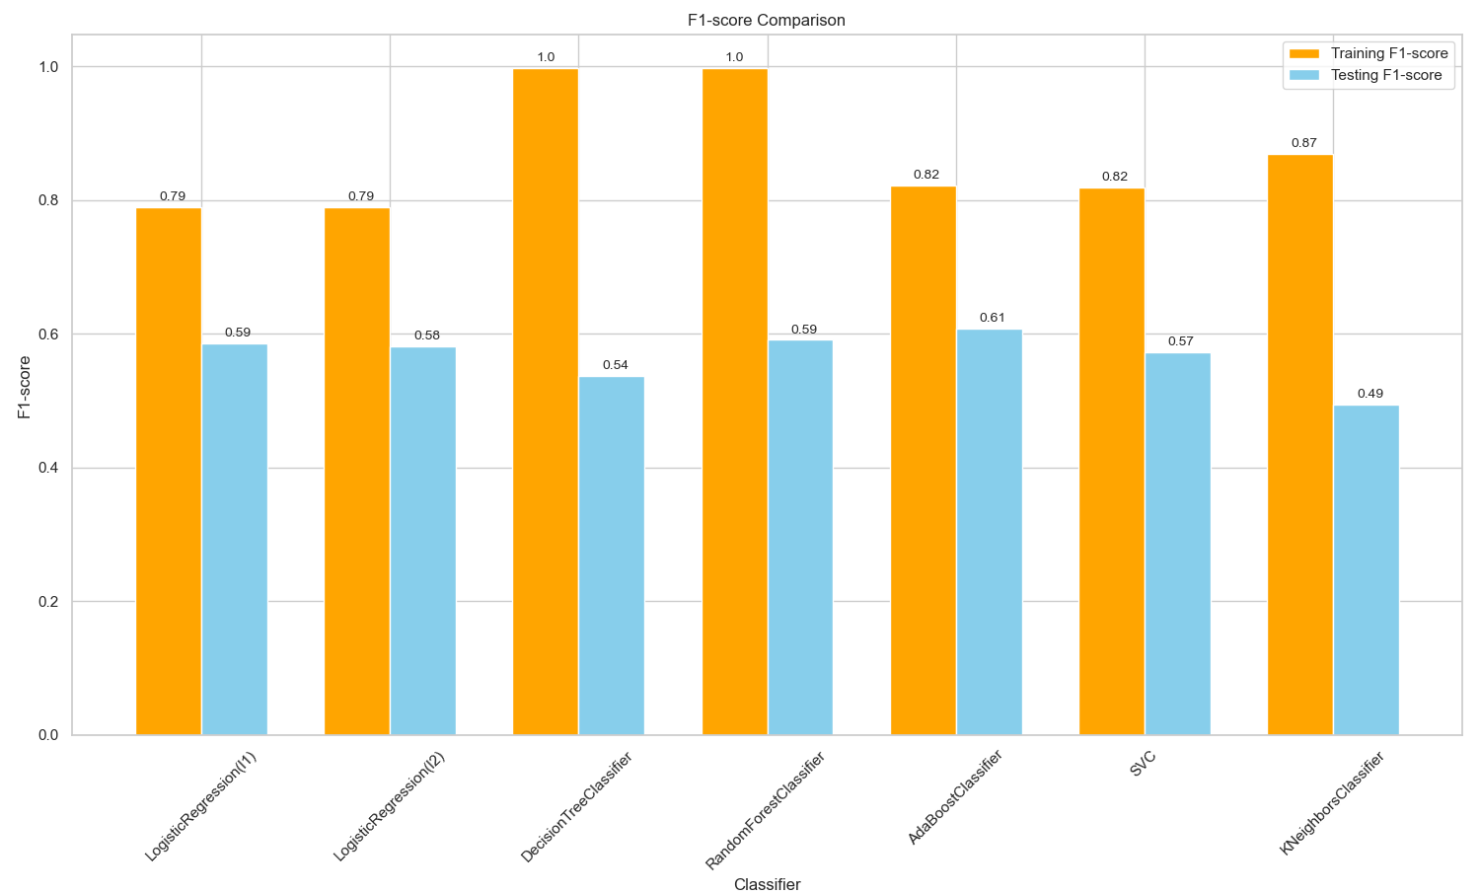
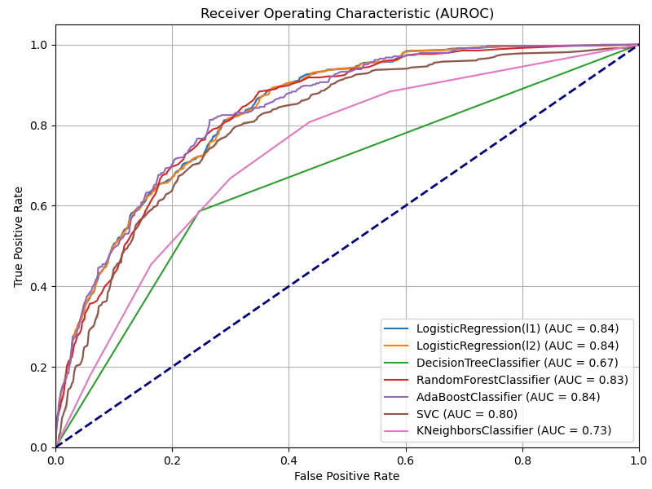
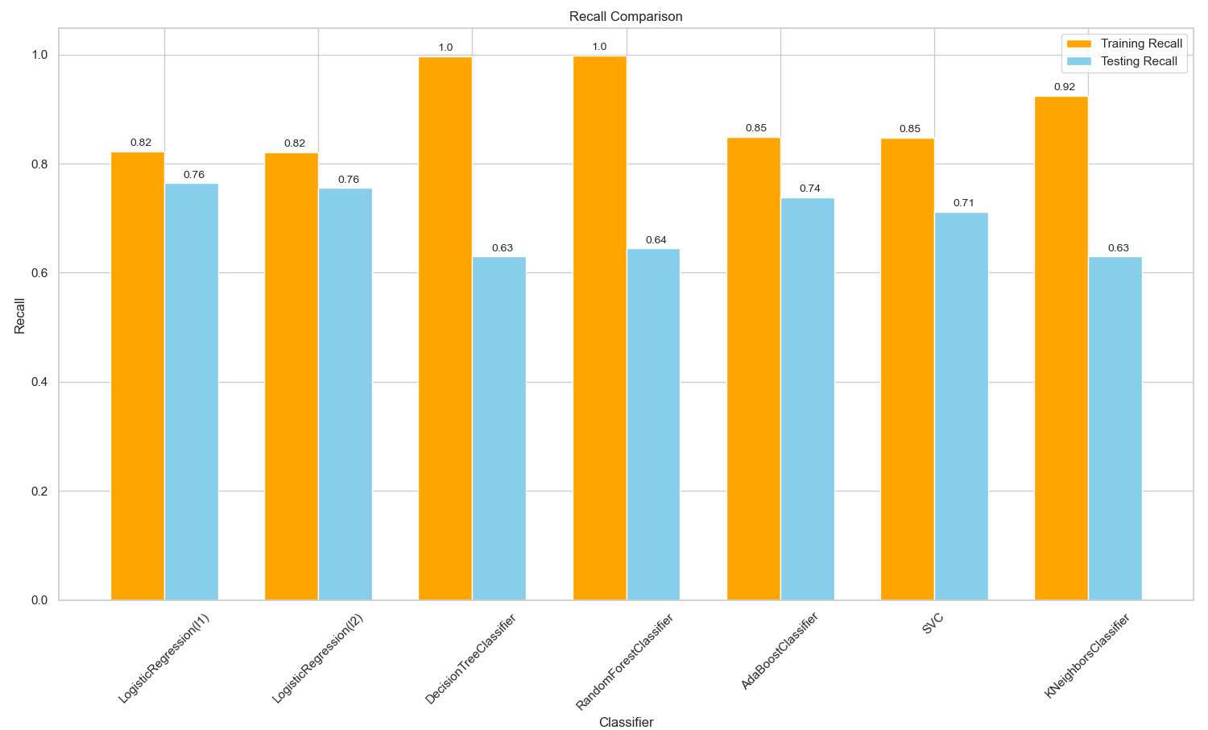
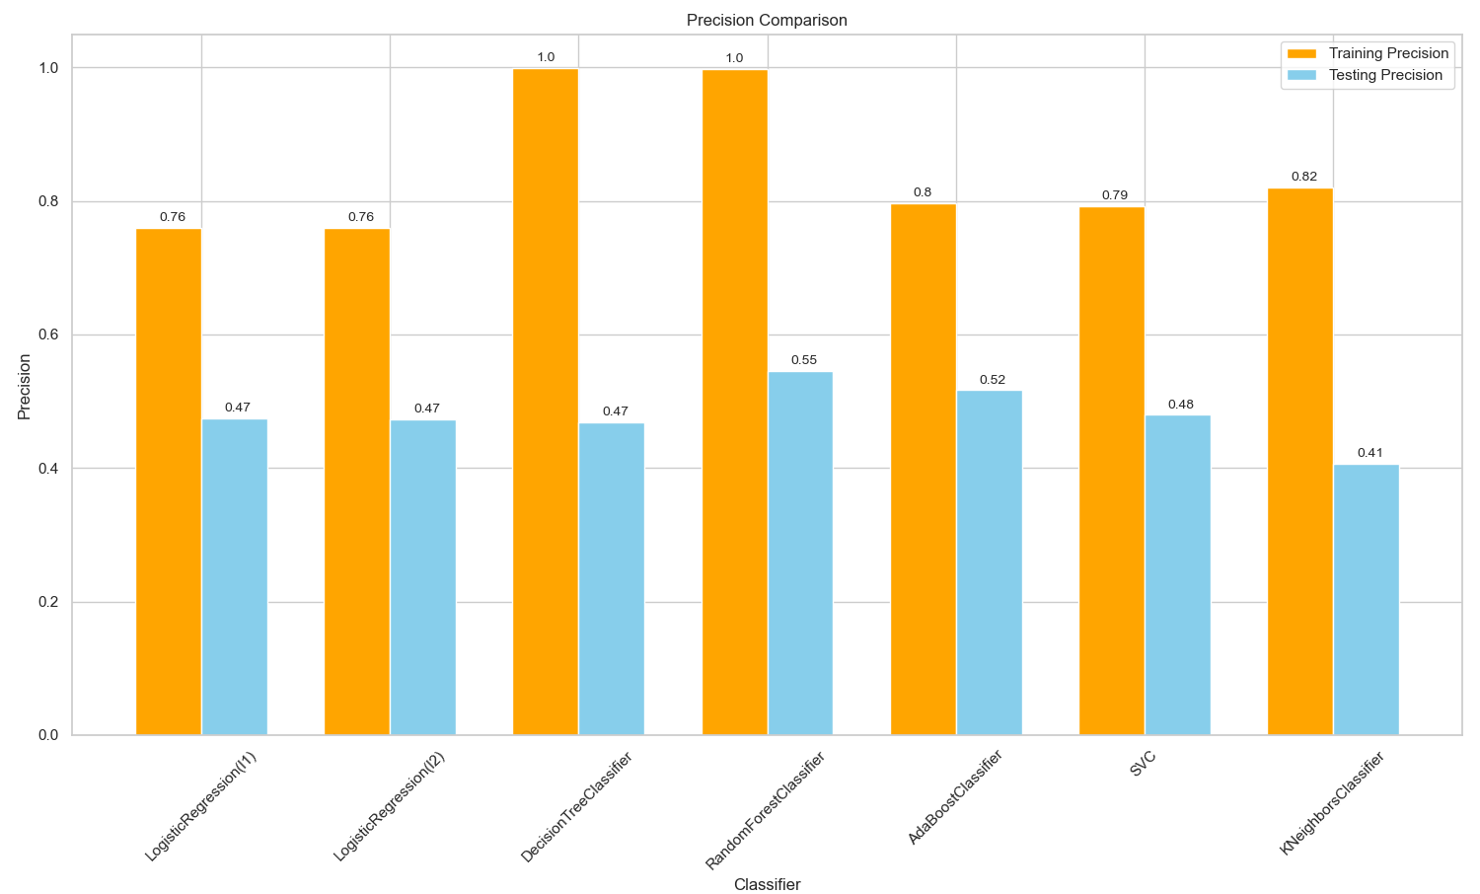
OVERSAMPLED METRIC VISUALIZATIONS

Slide 25
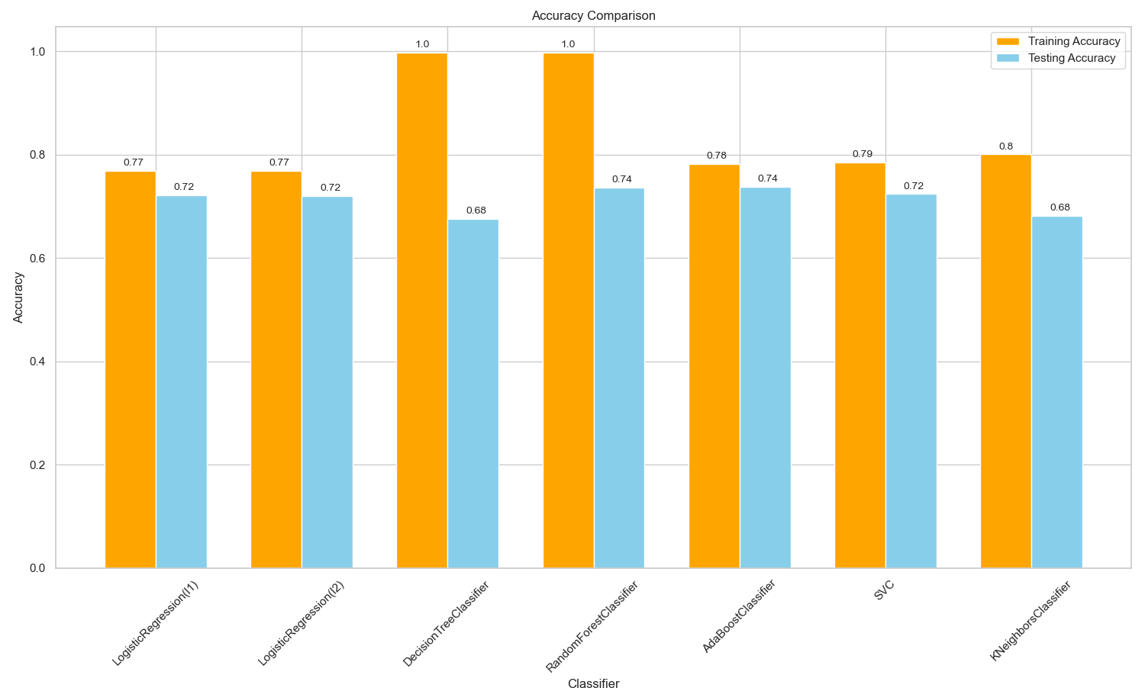
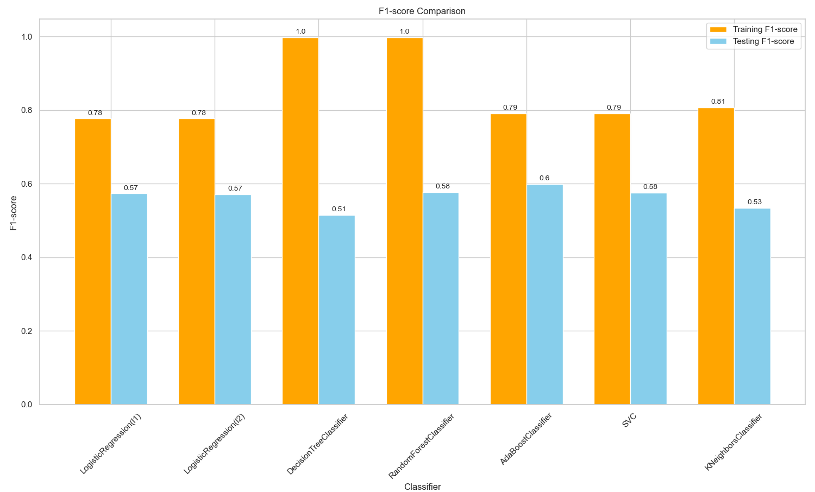
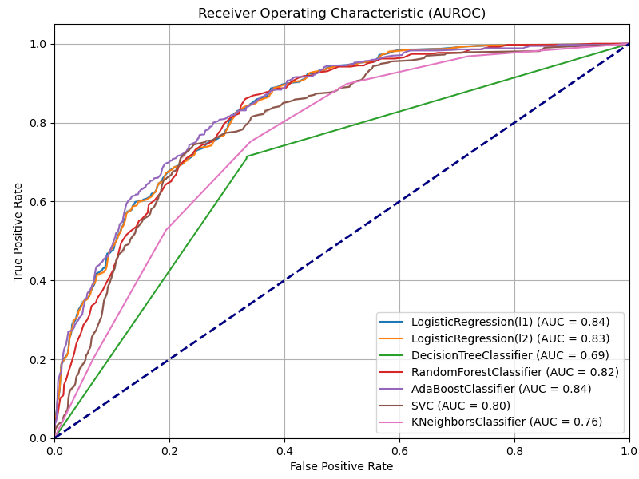
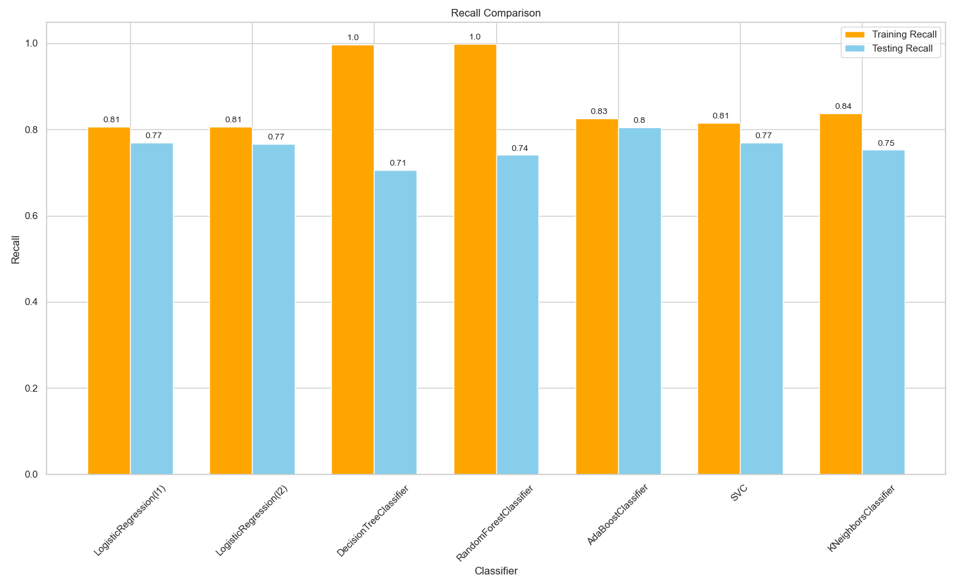
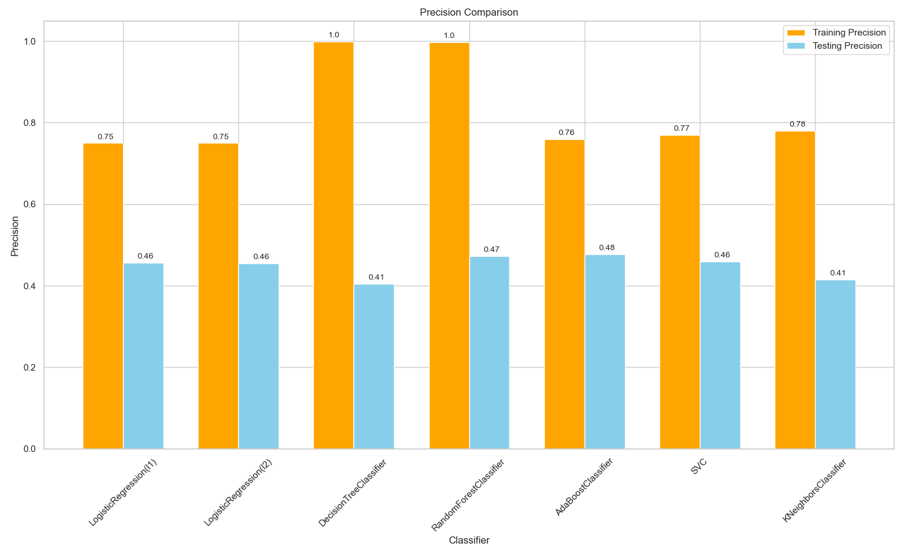
UNDERSAMPLED METRIC VISUALIZATIONS

Slide 26
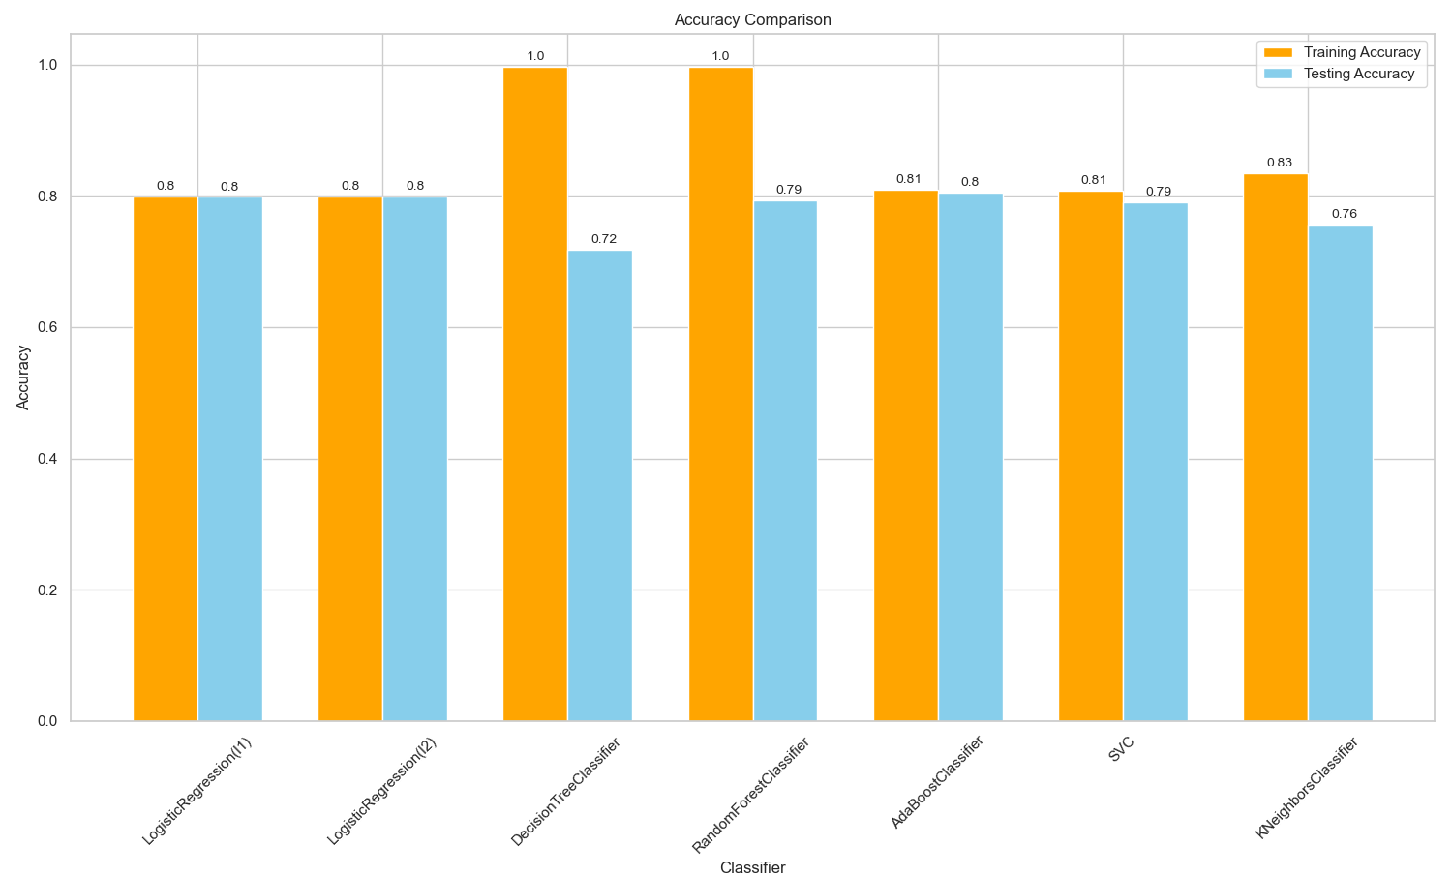
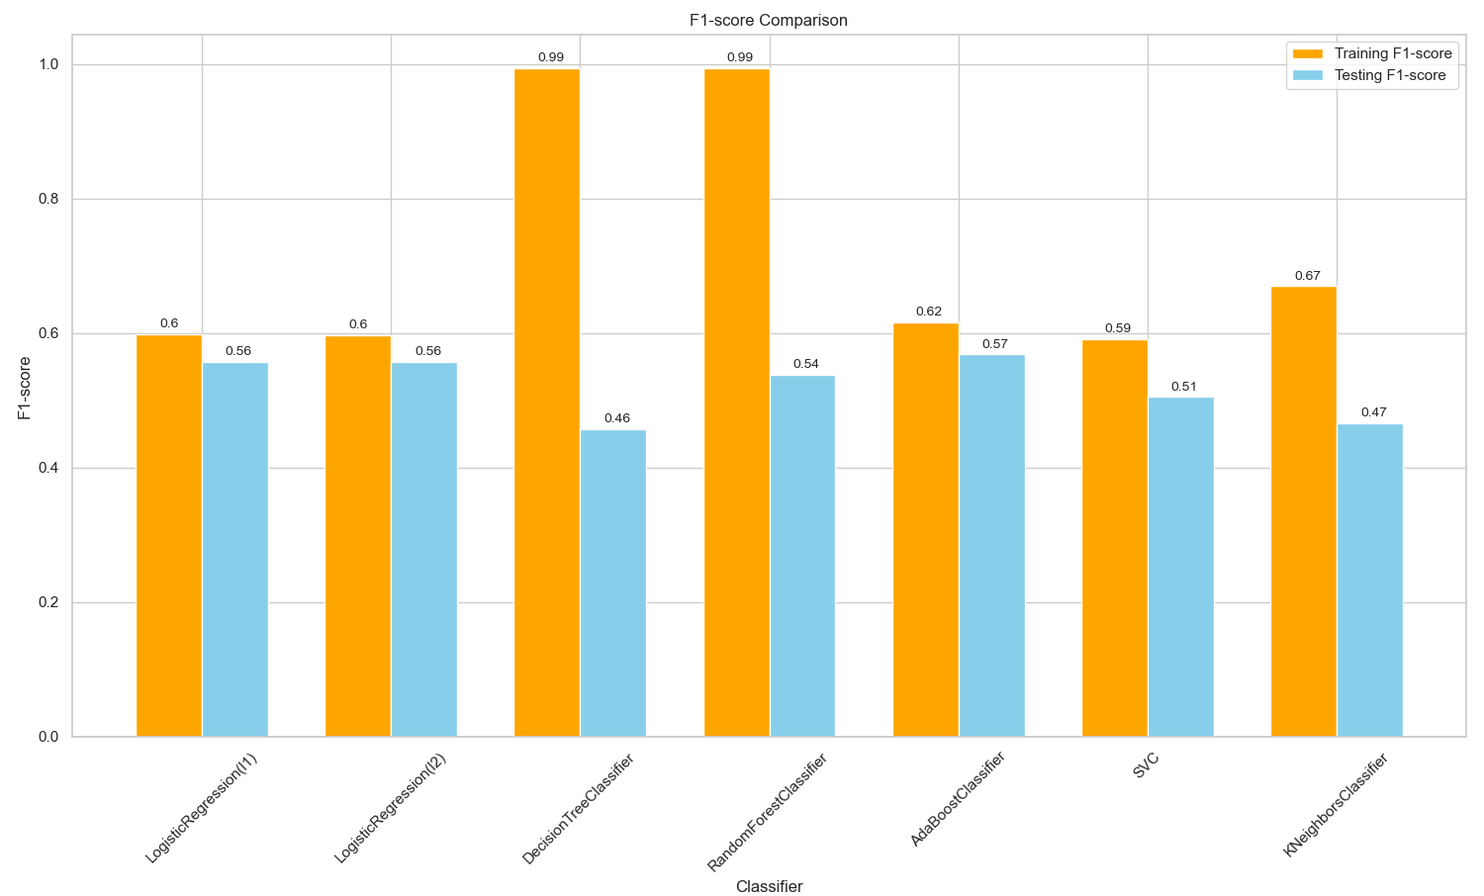
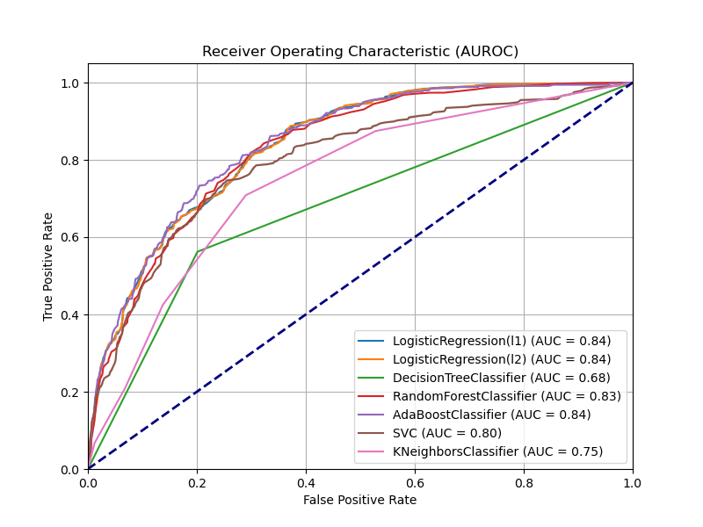
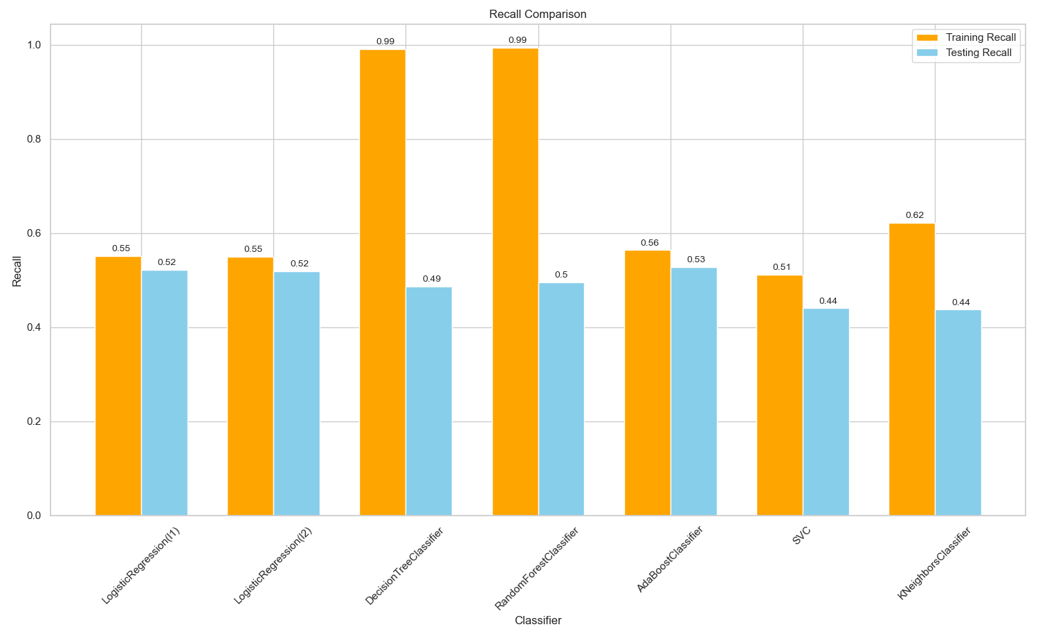
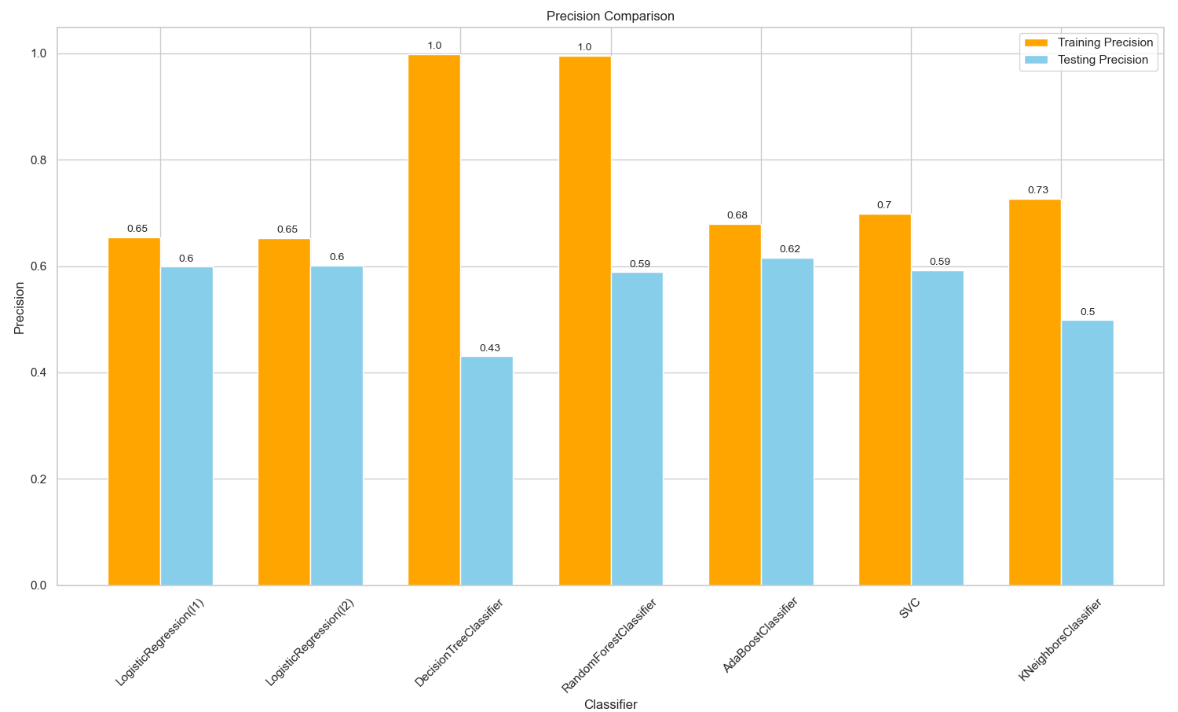
UNBALANCED DATA METRIC VISUALIZATIONS

Slide 27
THANK YOU
ANY QUESTIONS?

